Slide 1



Intro to Xamarin.Forms
Lori Lalonde
@loriblalonde

Slide 2
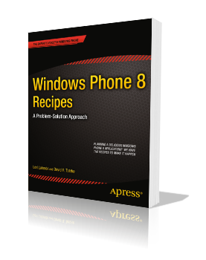

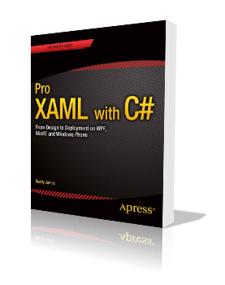



Me, Myself and I
CTTDNUG
Twitter: @loriblalonde
Email: loriblalonde@gmail.com
Blog: geekswithblogs.net/lorilalonde
LinkedIn: http://ca.linkedin.com/in/lorilalonde

Slide 3
Xamarin vs Xamarin.Forms

Slide 4

Xamarin’s Default App Architecture
iOS C# UI
Android C# UI
Windows C# UI
Shared App Logic
~75% - 90% code reuse
Shared App Logic in C#
Notes:
Good for apps with sophisticated UX requirements (complicated gestures, animations, design)

Slide 5

Xamarin.Forms App Architecture
Xamarin.Forms
Shared App Logic
~90 - 99% code reuse
Xamarin.Forms v1.3 - no support for Windows 8.1 or Windows Phone 8.1
Notes:
Good for forms based apps with many data entry screens
Xamarin just added support for application lifetime

Slide 6
Xamarin.Forms 1.4
Added support for Windows 8.1 and Windows Phone 8.1
Xamarin.Forms templates do not add 8.1 projects automatically
Some limitations
no support for: maps, gridview, loading embedded resources from another assembly

Slide 7
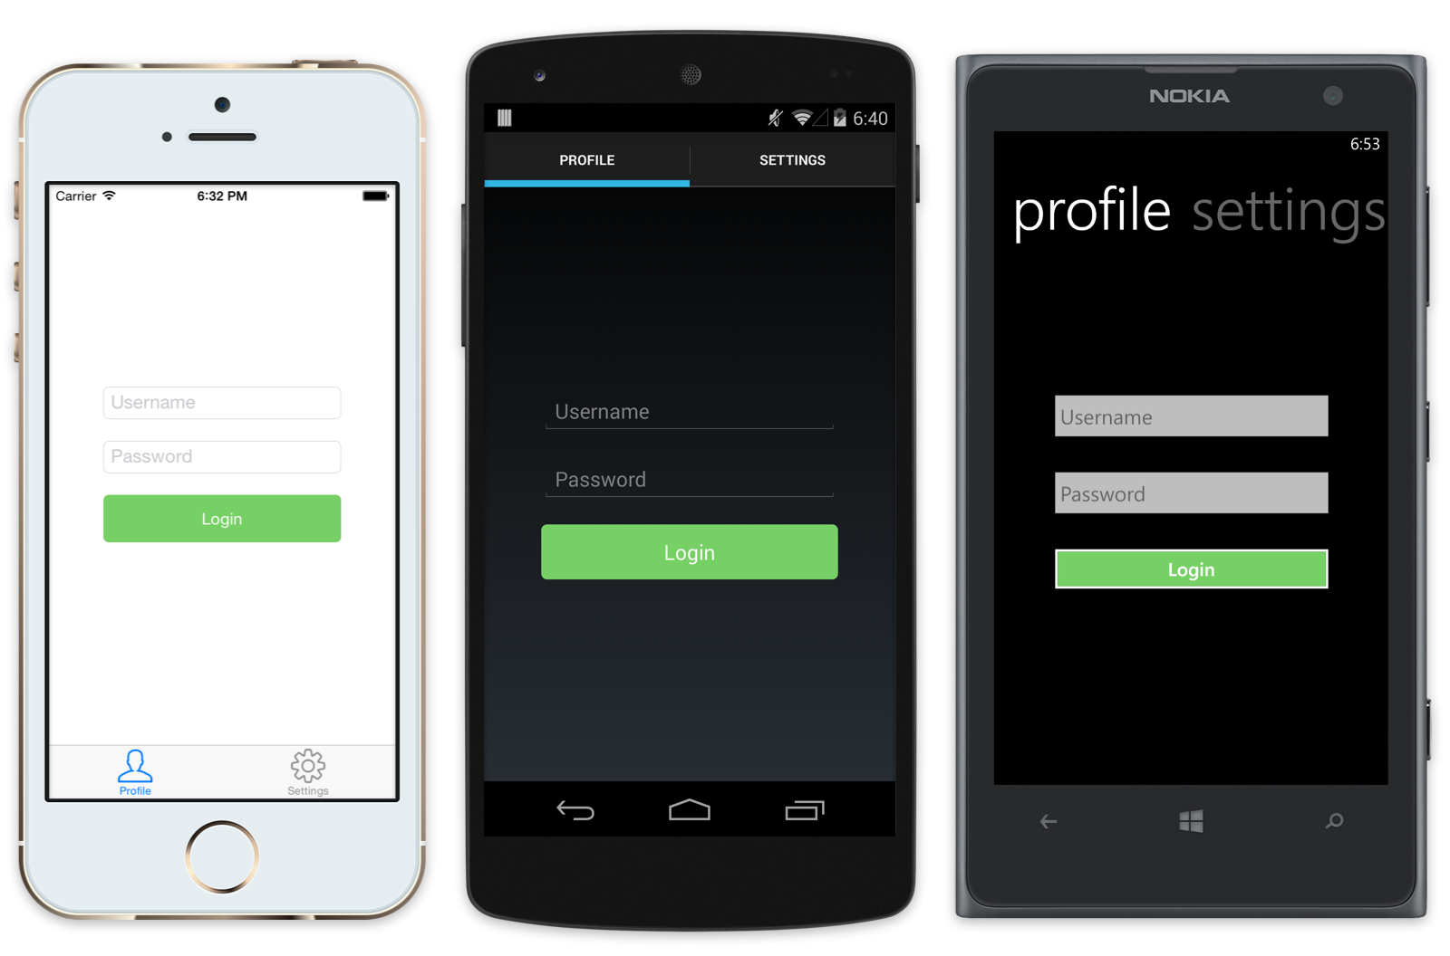
Xamarin.Forms: Build Native User Interfaces using Shared Code
Notes:
At runtime, each Xamarin.Forms page and its controls are mapped to platform-specific native user interface elements
Use a single API to generate native, platform-specific user interfaces

Slide 8


The Tools
OR
Xamarin Studio
+ Xamarin Plug-Ins
Notes:
Xamarin Studio – supports Android, iOS
Limitations – Xamarin.iOS only available on Mac, Windows Phone not supported
Mac Requirements – OS 10.8 (“Mountain Lion”) or higher, Xcode/iOS SDK, Xamarin Platform
Windows Requirements – Windows 7 or higher, Xamarin Platform, Connected to Mac (Xamarin.iOS dev only)

Slide 9
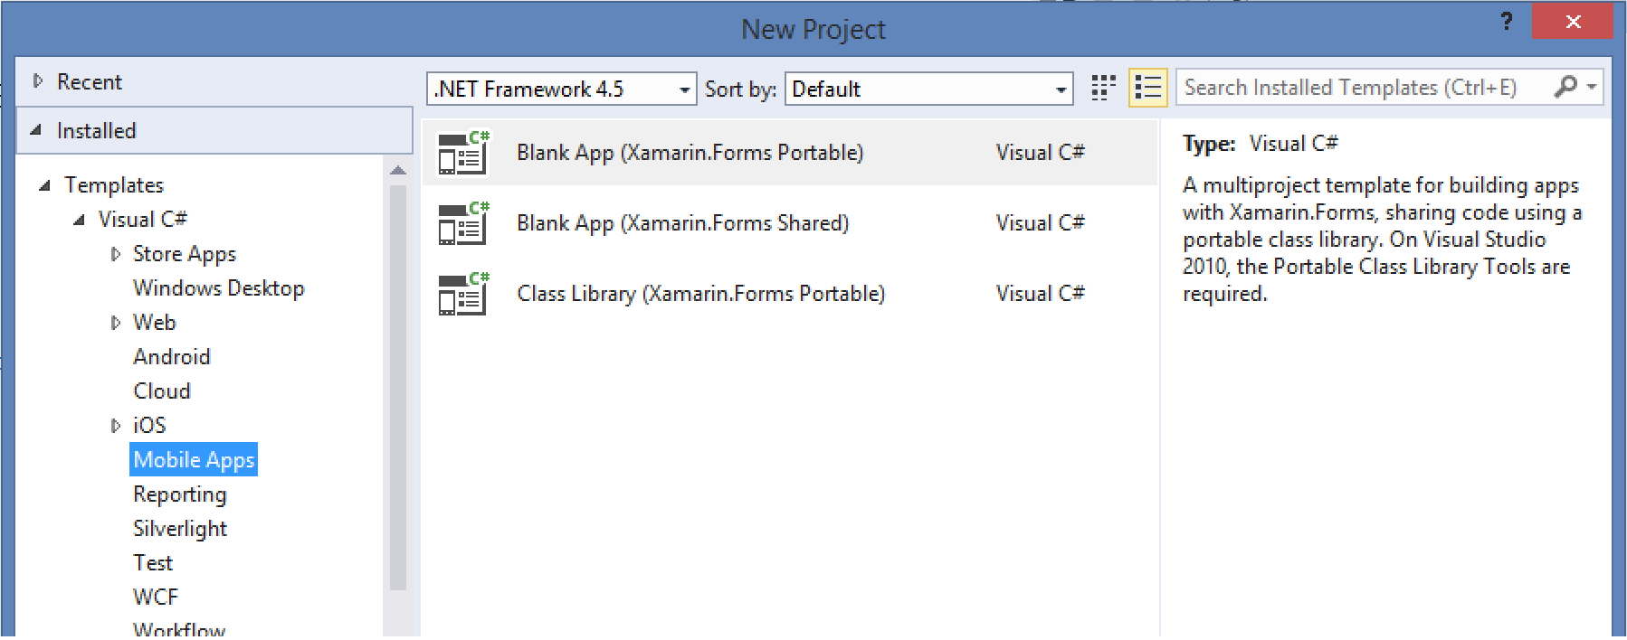
Xamarin.Forms Templates

Slide 10
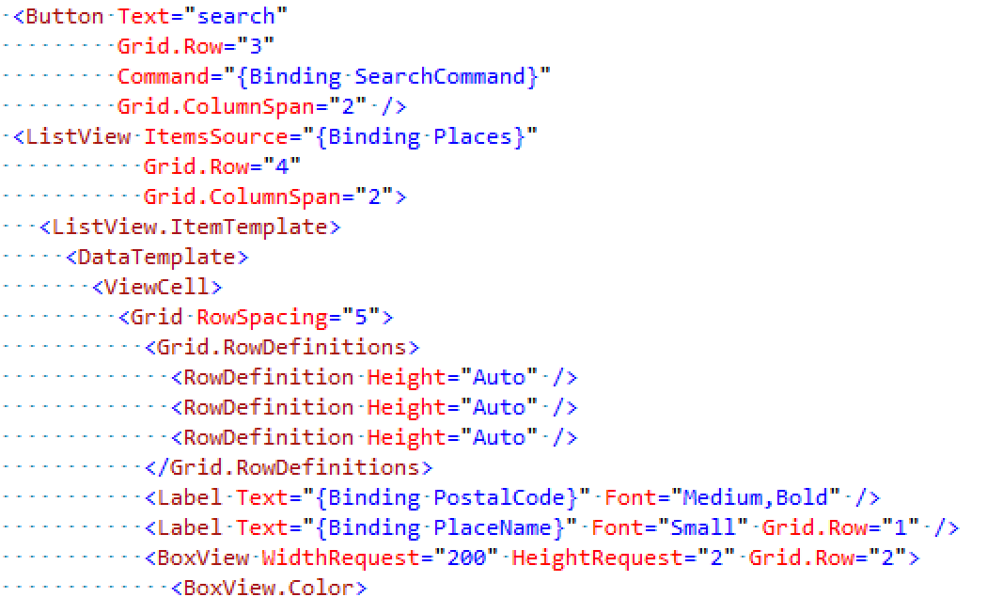
Supports Data Binding

Slide 11
Layouts and Controls

Slide 12
Pages
Content
Carousel
Master Detail
Navigation
Tabbed

Slide 13
Layouts
StackLayout
AbsoluteLayout
RelativeLayout
ScrollView
ContentView
Grid

Slide 14
User Interface Controls
Entry / Picker | View / Cell | Misc
Editor | BoxView | Label
Entry | ListView | Image
DatePicker | OpenGLView | Map
TimePicker | TableView | ActivityIndicator
Picker | WebView | ProgressBar
Stepper | ImageCell | SearchBar
Slider | EntryCell
Switch | TextCell
….and more

Slide 15
Let’s see what this looks like…

Slide 16
Platform-Specific Tweaks

Slide 17
Device Class
Static class which enables customization to layout and functionality by platform
Properties
Device.OS
Device.Idiom
Device.Styles
Methods
Device.GetNamedSize
Device.OnPlatform
Device.StartTimer
Device.BeginInvokeOnMainThread
Notes:
Device.OS - enables platform-specific checks to alter layout or functionality,
Device.Idiom - can be used to alter layouts or functionality depending on whether the device is a phone or a tablet
Device.Styles - built-in style definitions that can be applied to some controls‘
Device.OnPlatform – enable platform specific functionality, can pass in action to take when platformmatches, and can be configured in XAML
Device.GetNamedSize - can be used when setting FontSize in code
Device.OpenUri - method can be used to trigger operations on the underlying platform, such as open a URL in the native web browser
Device.StartTimer - method which provides a simple way to trigger time-dependent tasks that works in Xamarin.Forms common code
Device.BeginInvokeOnMainThread - Any background code that needs to update the user interface should be wrapped inside BeginInvokeOnMainThread

Slide 18
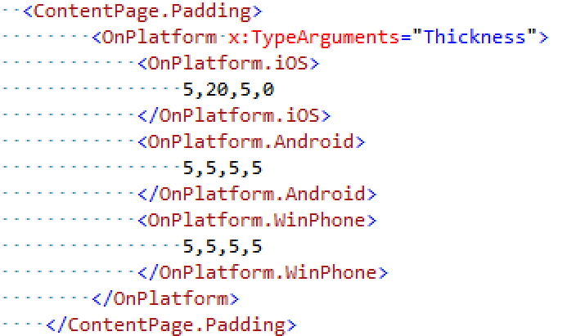
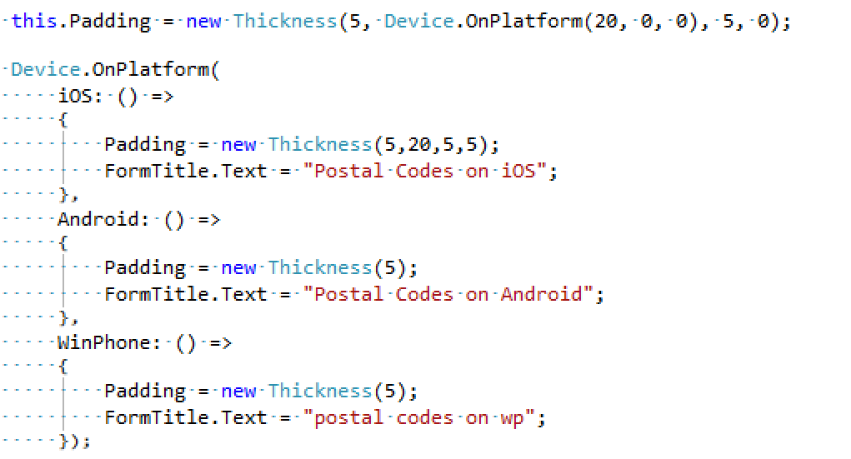
Device.OnPlatform Example
XAML
Code Behind
Notes:
Device.OnPlatform
Device.OpenUri
Device.StartTimer
Device.BeginInvokeOnMainThread

Slide 19
Let’s apply some platform tweaks…

Slide 20
Questions?

Slide 21
Additional Resources
Xamarin Developer Documentation – http://developer.xamarin.com
Book: Xamarin.Forms by Charles Petzold - http://developer.xamarin.com/guides/cross-platform/xamarin-forms/creating-mobile-apps-xamarin-forms/
Xamarin.Forms Samples - http://developer.xamarin.com/samples/xamarin-forms/all/

Slide 22
Additional Resources (continued)
Xamarin Forms Labs - https://github.com/XLabs/Xamarin-Forms-Labs
James Montemagno – https://github.com/jamesmontemagno
Craig Dunn - https://github.com/conceptdev

Slide 23
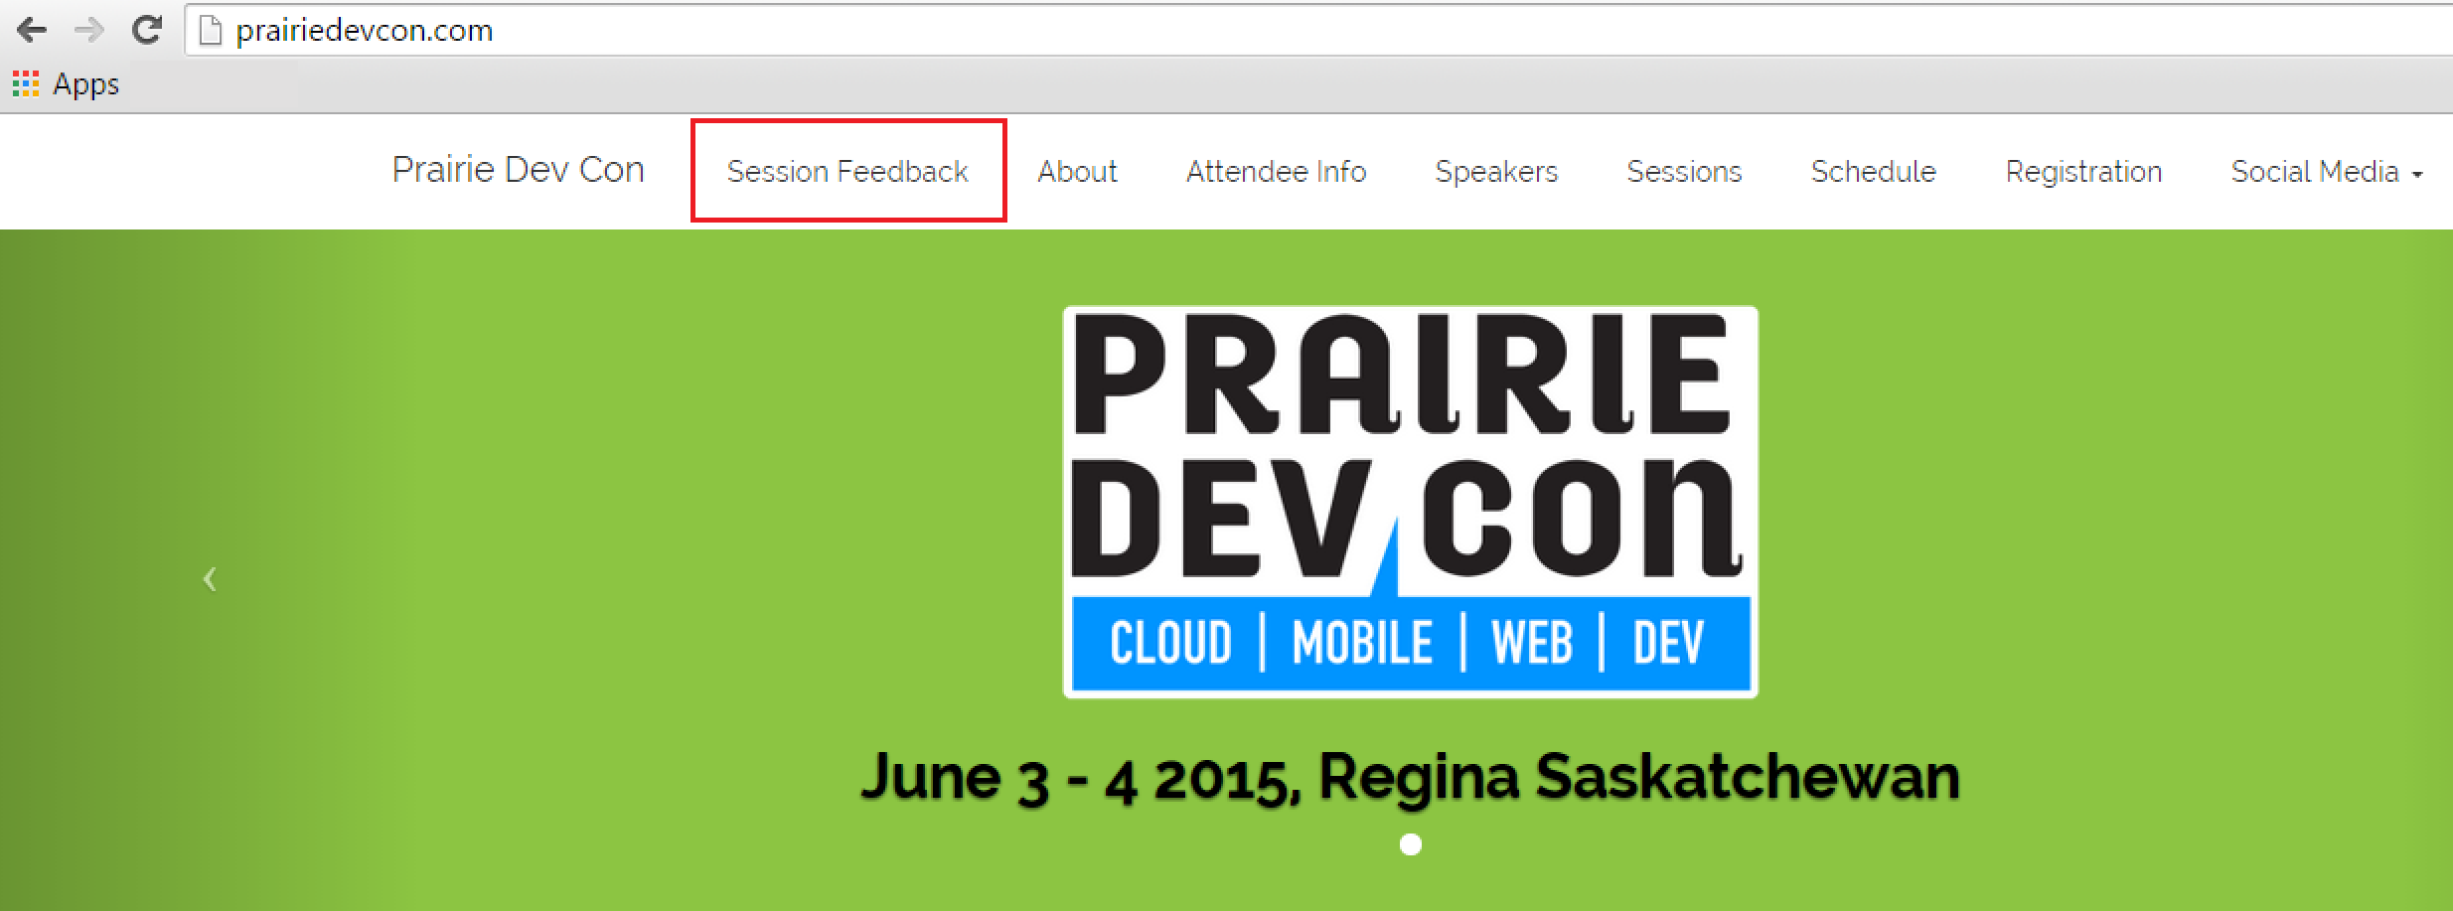
Please fill out the session survey…
Your feedback matters!

Slide 24
Thanks!
Twitter: @loriblalonde
Email: loriblalonde@gmail.com
Blog: geekswithblogs.net/lorilalonde
LinkedIn: http://ca.linkedin.com/in/lorilalonde

